Slide 1
SecArchUnit
Extending ArchUnit to support
validation of security architectural constraints
Marcus Randevik
Patrik Olson

Slide 2
Agenda
Background
Software Architecture
Architectural constraints
Archunit
Methodology
Selection of constraints
Implementation of constraints
Evaluation
Conclusions

Slide 3
Software Architecture
“The software architecture of a program or computing system is the structure or structures of the system, which comprise software elements, the externally visible properties of those elements, and the relationships among them.” - Bass et al¹
[1]
L. Bass, P. Clements, and R. Kazman, Software architecture in practice, 2nd ed. Boston: Addison-Wesley, 2003.

Slide 4
Software Architecture
Intensional vs extensional
Local vs non-local
Architecture | Design
Intensional | Intensional
non-local | local
A. H. Eden and R. Kazman, “Architecture, design, implementation,” in 25th International Conference on Software Engineering, 2003. Proceedings., Portland, OR, USA, 2003, pp. 149–159, doi: 10.1109/ICSE.2003.1201196.

Slide 5
Security architectural constraints - CIAA
Confidentiality:
Integrity:
Availability:
Accountability:

Slide 6
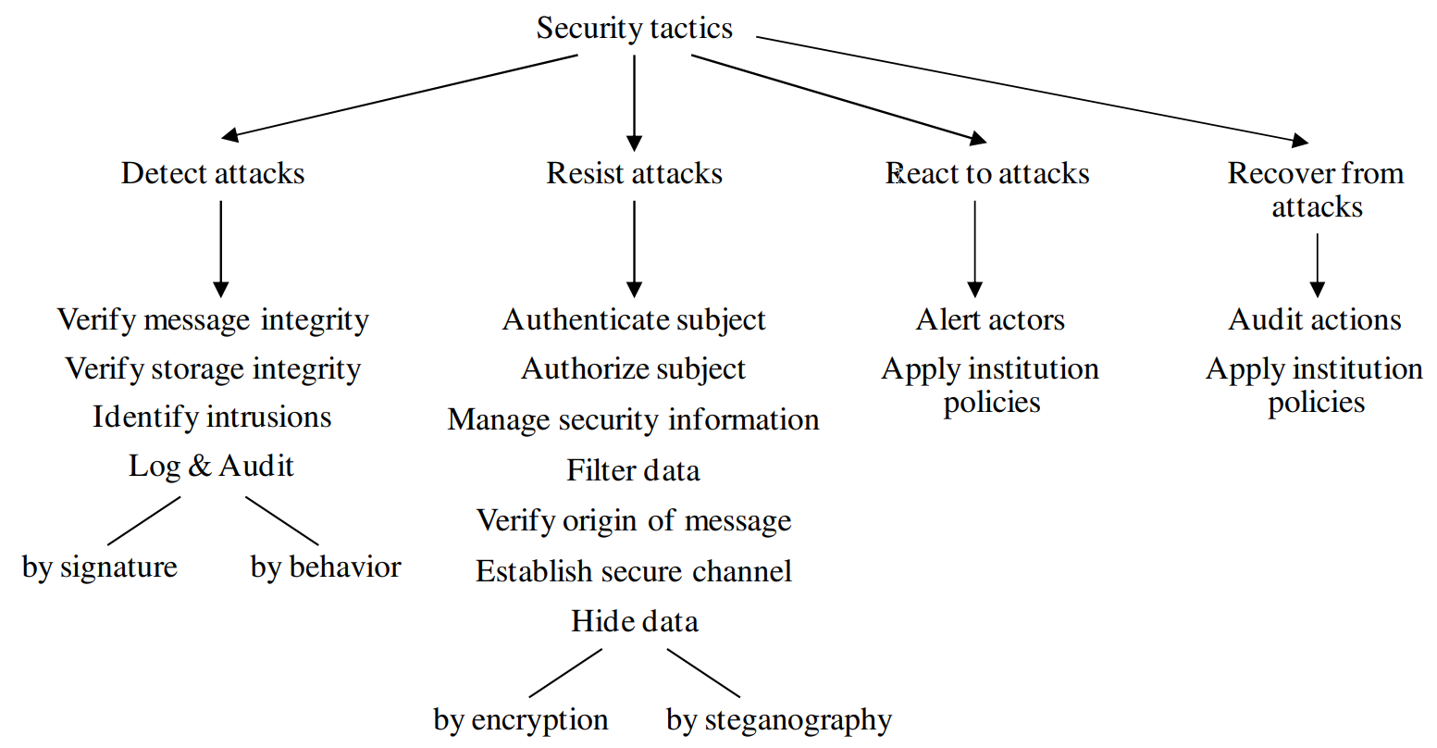
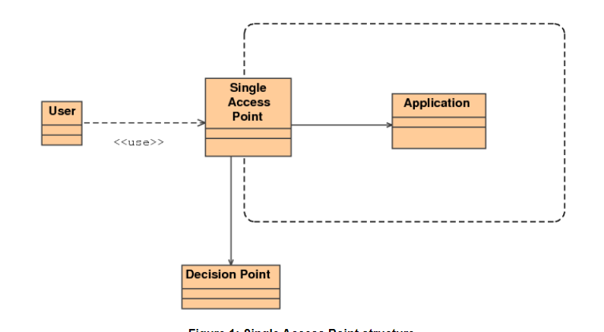
Security architectural constraints - concepts
Principles
Tactics
“The principle of least privilege”
“Layer X must not access layer Y”
Patterns
Rules

Slide 7
ArchUnit
Static analysis library
Constraints described as rules
Rules can be evaluated using JUnit
Source code | ArchUnit
Methods, constructors, static initializers | Code units
Fields and code units | Members of a class
Field accesses, method calls and constructor call | Access

Slide 8
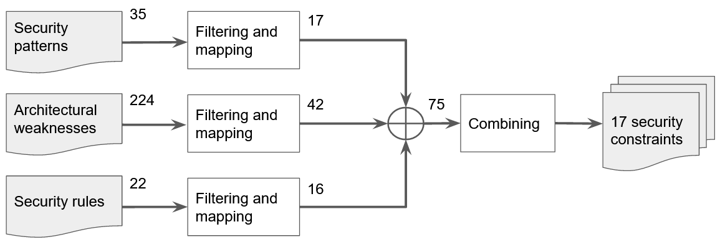
Methodology - Identification of constraints

Slide 9
Methodology - Evaluation
Three tools: SecArchUnit, SonarQube and PMD
Constraints applied to three systems
Evaluated on performance (precision and recall) and usability

Slide 10
Methodology - Establish ground truth
1
2
Analyze system for constraint violations
Analyze system for constraint violations
Apply necessary information
Apply necessary information
Compare results

Slide 11
Selected constraints
# | Description | Security goal
1 | Methods related to security events must call the logger | Accountability
2 | Authentication and authorization must each be enforced in a single component | Accountability
3 | Every outbound message must be sent from a single component responsible for transmissions | Confidentiality
4 | Input from a user must pass through a component validating the data | Integrity
5 | Spawning of threads must be limited or throttled | Availability
6 | Sensitive information must not bleed to components with lower security classification | Confidentiality
7 | Secrets must not be exposed in log messages | Confidentiality

Slide 12
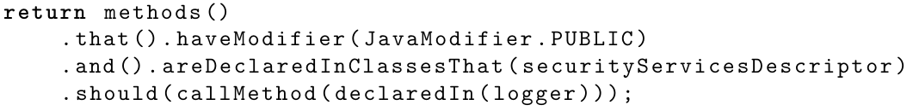

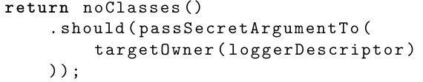
Implementation of constraints
3 categories
Use existing functionality
Constraint 1: Methods related to security events must be logged
Add information to source code
Annotations
Constraint 4: Input from a user must pass through a component validating the data
Extend ArchUnit’s analysis
Information flow analysis
Hints: reference type and originating member
Constraint 7: Secrets must not be exposed in log messages
“The constructs that match predicate should fulfill condition”

Slide 13
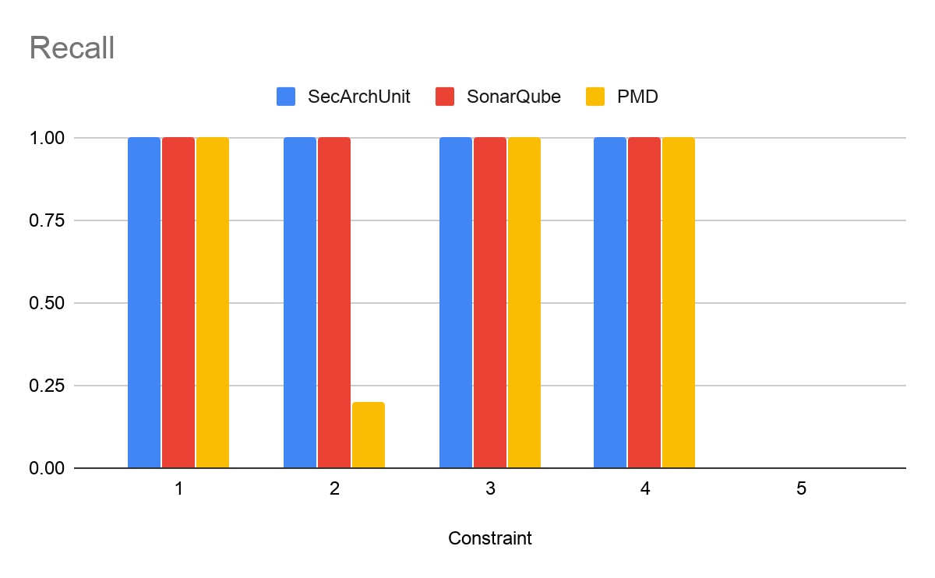
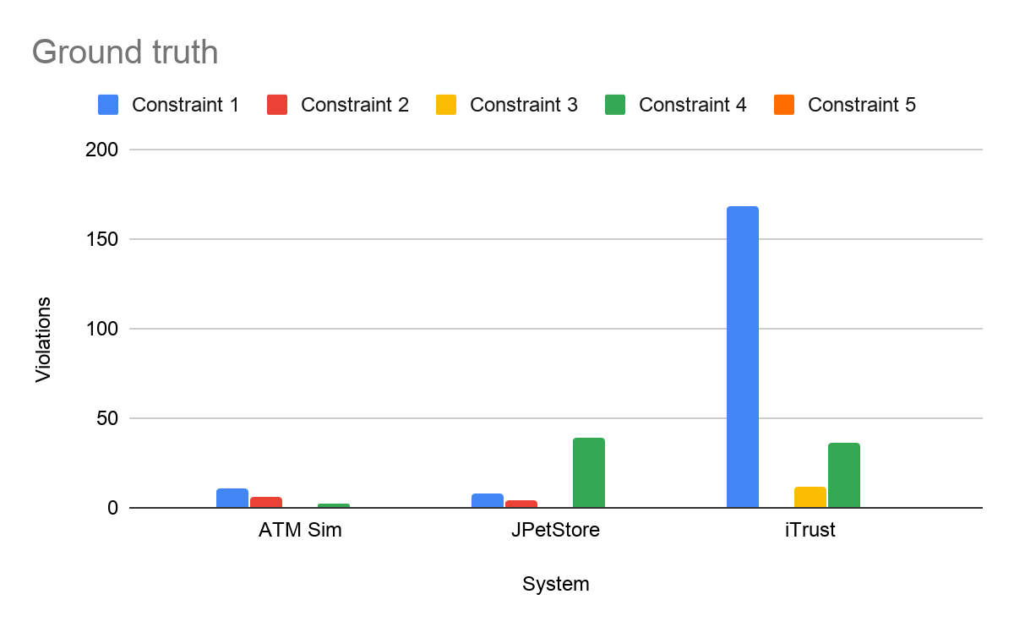
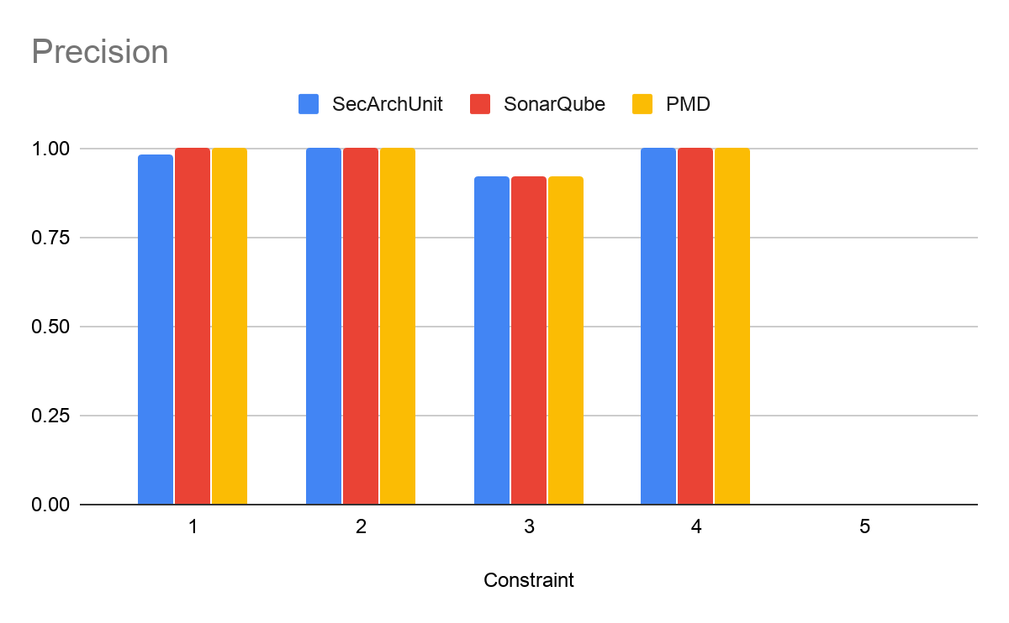
Evaluation of performance
Constraints 1-5

Slide 14
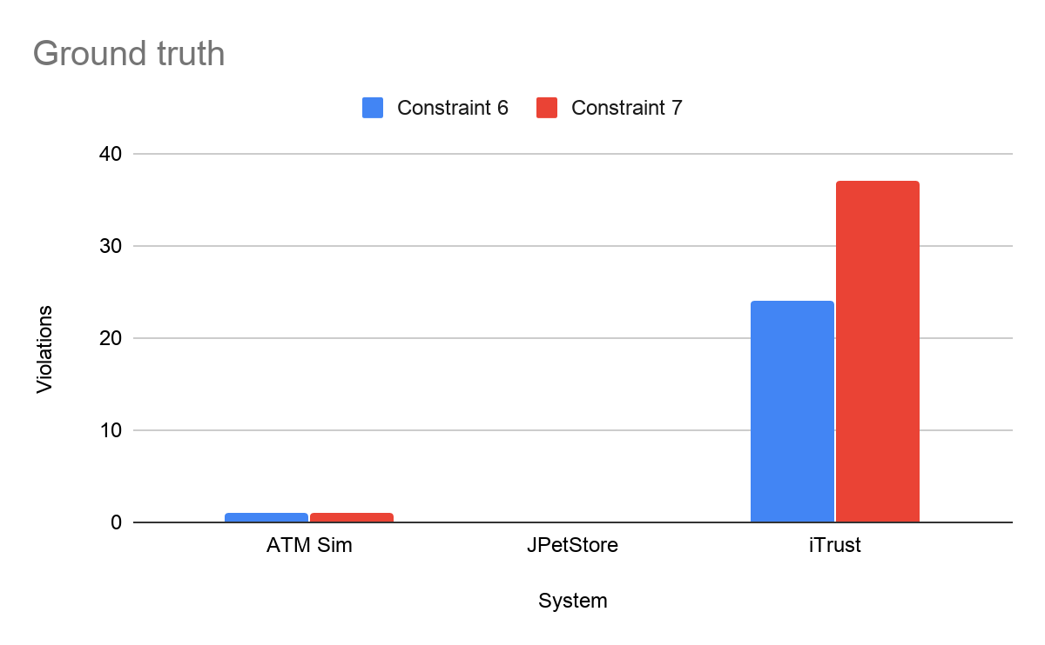
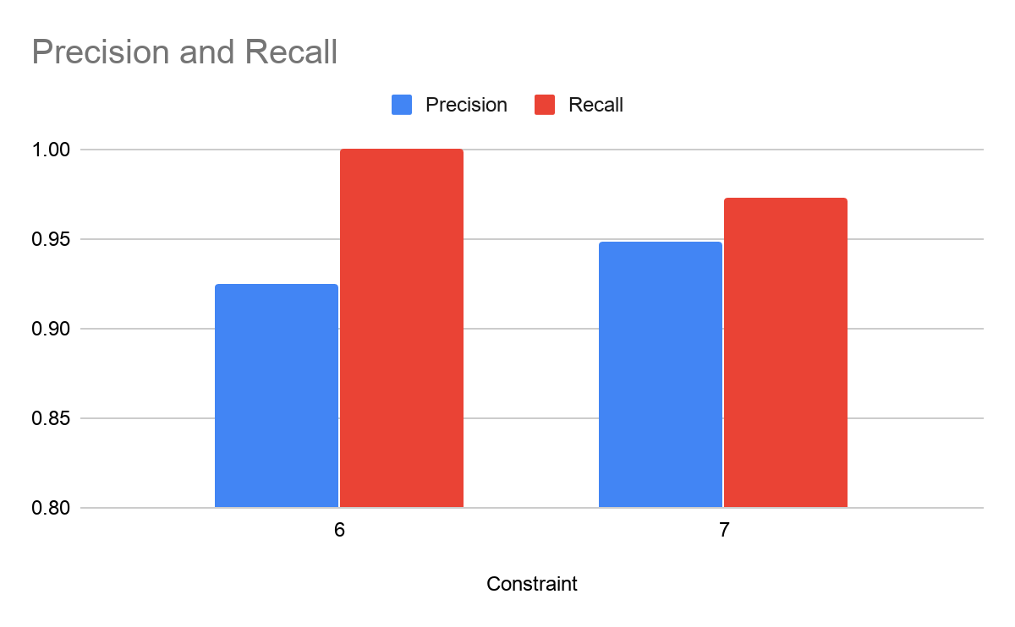
Evaluation of performance
Constraints 6-7
injected

Slide 15
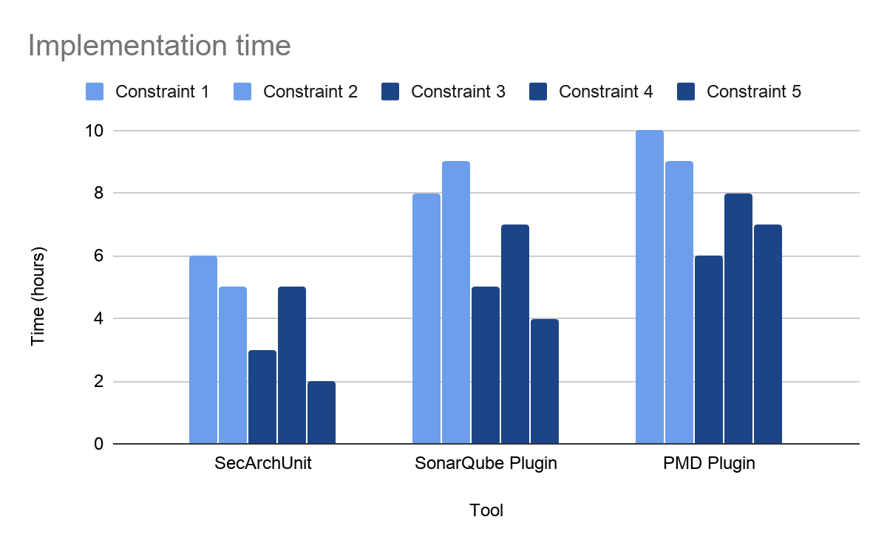
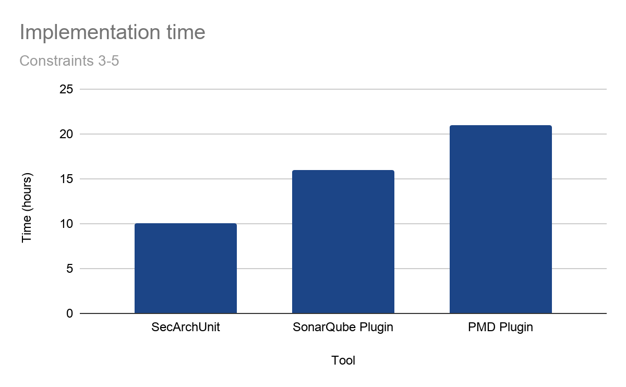
Evaluation of usability
+110%
+60%

Slide 16
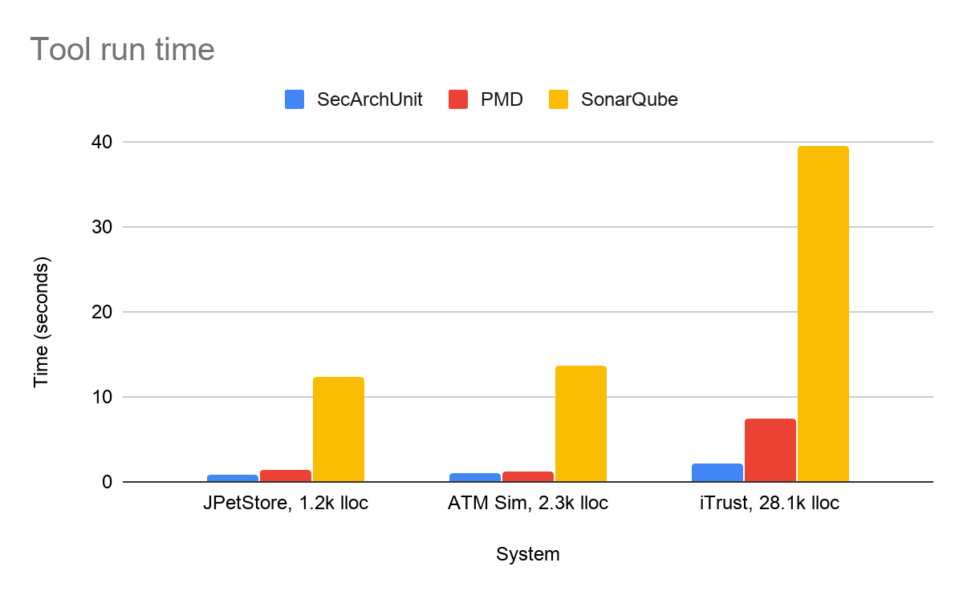
Evaluation of usability

Slide 17
Conclusions
What architectural security constraints can be validated using ArchUnit?
Confidentiality, Integrity, Accountability
Performance comparable to industry tools
Better usability
What modifications can be made to ArchUnit to validate additional constraints?
Information flow analysis
Confidentiality

Slide 18
Thank you for listening!

